Slide 1

Priority Inversion and Priority inheritance protocol

Slide 2
Priority inversion
Higher priority task is blocked by a lower priority one.
May be caused by semaphore usage, device conflicts, bad design of interrupt handlers, poor programming and system design.

Slide 3
A typical priority-inversion scenario
τ
Blocked
1
Normal Execution
τ₂
Critical Section
τ₃
t₀ t₁ t₂ t₃ t₄
t₅ t₆
t₇ t₈ Time

Slide 4

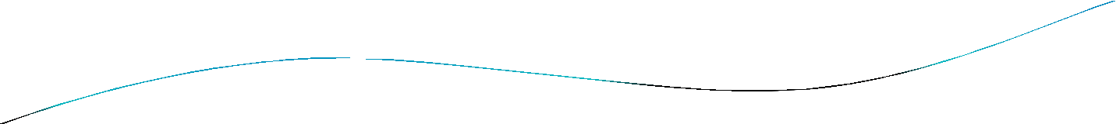



Priority inheritance protocol
A solution to the priority inversion problem such that when a task blocks one or more higher-priority tasks, it temporarily inherits the highest priority of the blocked tasks.
The highest-priority task T₁ relinquishes the processor whenever it seeks to lock the semaphore guarding a critical section that is already locked by some other job.
If a task T₁ is blocked by T₂ and , (i.e. has precedence over ) task T₂ inherits the priority of T₁ as long as it blocks T₁. When T₂ exits the critical section that caused the block, it reverts to the priority it had when it entered that section.
Priority inheritance is transitive. If T₃ blocks T₂, which blocks T₁, then T₃ inherits the priority of T₁ via T₂.

Slide 5

Illustration of the priority- inheritance protocol
τ
Blocked
1
Priority Inherited
Normal Execution
τ₂
Critical Section
τ₃
Priority Reverted
t₀ t₁ t₂ t₃ t₄ t₅
t₆
t₇ t₈ Time

Slide 6

Priority inheritance protocol
Priority inversion occurred in 1997 in NASA’s Mars Pathfinder Space
mission’s Sojourner rover vehicle.
Mil-std-1553B information bus manager was synchronized with semaphores.
A meteorological data gathering task that was of low priority and low frequency blocked a communications task that was of higher priority and higher frequency.
This infrequent scenario caused the system to reset.
The problem would have been avoided if the priority inheritance mechanism had been used. But it had been disabled.
Fortunately, the problem was diagnosed in ground based testing and remotely corrected by re-enabling the priority inheritance mechanism

Slide 7
Priority ceiling protocol
The Priority Ceiling Protocol extends the Priority Inheritance Protocol through chained blocking in such a way that no task can enter a critical section in a way that leads to blocking it.
Each resource is assigned a priority (the priority ceiling) equal to the priority of the highest priority task that can use it.
The Priority Ceiling Protocol is the same as the Priority Inheritance Protocol, except that a task, T, can also be blocked from entering a critical section if there exists any semaphore currently held by some other task whose priority ceiling is greater than or equal to the priority of T.

Slide 8
Illustration of the priority-ceiling protocol
Acquire S₁
τ₁
Attempt to Acquire S₁
Acquire S₁
Acquire S₂
Acquire S₂
τ
2
τ₃
t₀ t₁ t₂ t₃
t₄
t₅ t₆
t₇ t₈ t₉ Time

Slide 9
Summary
What is Priority Inversion
Illustration of Priority inversion
Need of Priority inheritance
Priority Inheritance protocol
Illustration
Draw backs of Priority inheritance protocol
Priority Ceiling Protocol and Illustration
Ref: https://youtu.be/lFpYEaXHV5A

